Slide 1

Transfer Efficacy & Goal Orientation Among Potential Transfer Students: An Exploratory Study (Buenaflor & Cabrera, 2023)
Economic Inquiry in Education
(EDU-633-001)
American University
November 11, 2024
Guest Speaker:
Dr. Alberto F. Cabrera
Scholar-in-residence, Center for Postsecondary Readiness & Success
College of Education, American University
Professor Emeritus, Higher Education at UMD
Notes:
Borrador de agenda
1. Introducción de los participantes…. 20 minutos
2. Presentación sobre lo que he aprendido sobre implicación social del estudiante. Véase nexo aquí…..20 a 30 minutos
3. Preguntas ... .30 minutos
4. Discusión grupal…20 minutos

Slide 2

Agenda
Introducción
Títulos en educación superior en los EEUU
El contexto y el problema
Preguntas de investigación
Modelos conceptuales
Modelo de autoeficacia en transferirse a la universidad (Buenaflor, 2021)
Teoría social cognitiva del desarrollo de carrera (Lent, Brown y Hacket, 2002)
Teoría de aprendizaje social (Bandura, 1988) y de fuentes de autoeficacia (Bandura, 1994)
Teoría de fijación de metas u objetivos (Locke y Latham, 2002)
Metodología
Conectando constructos con indicadores
Población objetivo
Conclusiones
Aplicaciones

Slide 3
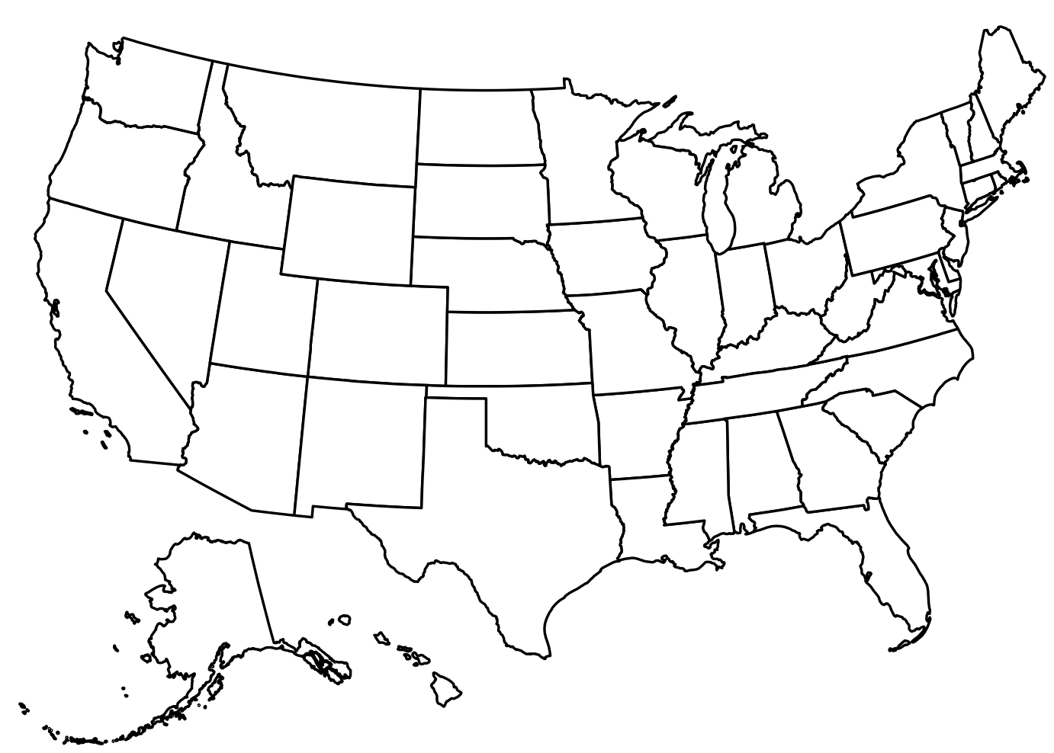
A quick glance
Population: 341,814,420.
Around 19.2 million students (undergraduate and postgraduate) are enrolled in 3,896 higher education institutions (2-year and 4-year) (NCES projection).
Only 50 (1.9%) universities have 35 thousand or more students enrolled.
Sources: Tables 303.10 , 303.80 and 317.10 of Digest of Education Statistics, US Census, College Express. The 50 largest US colleges and Universities.

Slide 4



American Postsecondary Degrees
PhD
Postsecondary degrees range from associate (awarded by community colleges) to doctorate (awarded by universities).
Master’s
43% of 2023 High School graduates enrolled in colleges and universities. 18.5% enrolled in community colleges
Baccalaureate
Only 32% of fall 2015 entering community college students transferred within 6 years.
Associate Degree
(Equivalent to the first two years of the BA degree)
Sources: Table 302.10 Digest of Education Statistics, Velasco et al (2024). Tracking transfer

Slide 5
Community colleges at a Glance
Key insights
Community colleges are the main gateway to higher education for underrepresented students.
There are 1,026 community colleges in the US, representing 26% of higher education institutions.
In 2021-22, community colleges awarded 849,111 associate degrees and 22,776 BA degrees
The average community college student is 27 years old.
Most community college students are women (58%)
32% of community students are the first in their family to go to college
55% of them receive financial support
38% of all US undergraduate students
36% of first-time freshmen
53% Native American
48% Hispanic
39% African American
34% Asian Pacific Islander
Sources: AACC Fast Facts 2024; Table 317.10 Digest of Education Statistics
Notes:
Title IV degree granting institutions according to Table 317,10 as prepared January 2024
2-year colleges = 1,268 while ACC reports 1,026
4-year colleges = 2,628,
Total: 3,896

Slide 6
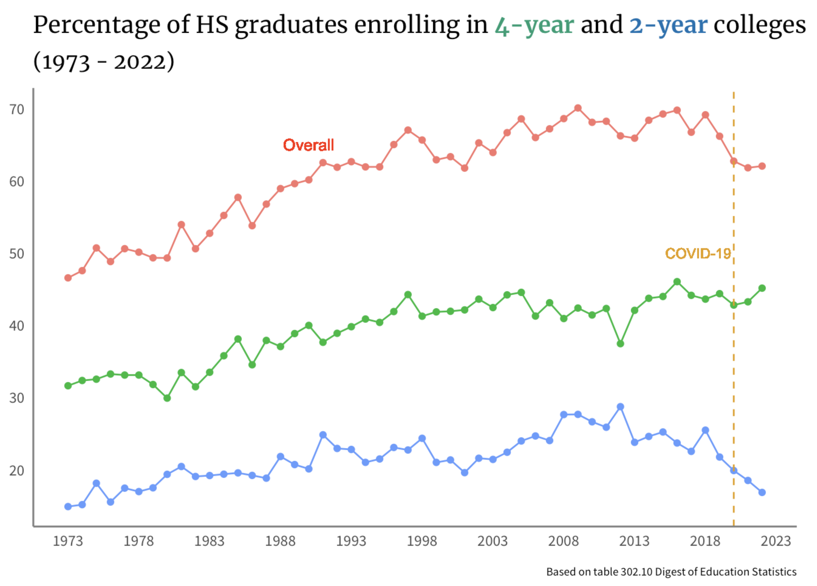
The problem
From 2018 to 2021, the proportion of HS graduates who enrolled in higher education decreased by 7%, or 225,000.
The percentage of HS graduates enrolling in community colleges declined at higher pace next to the national trend (8.6%).
The proportion of community college graduates who transferred to four-year colleges decreased by about 8% between 2021 and 2022 ( National Student Clearinghouse, 2023)
In Spring 2024, the National Student Clearinghouse reported recovery of transfer rates. The overall transfer rate in fall 2023 grew 5.3 % next to fall 2022.

Slide 7



Research questions
Is transfer efficacy composed of four unique, but interrelated sub constructs (namely, mastery experiences, social persuasion, vicarious experiences, and reduction of stress)?
What constitutes goal orientation towards transferring among community college students?
What is the impact of self-efficacy on goal orientation among community college students?
Notes:
El propósito de este estudio es tener una visión más clara del rol de autoeficacia y claridad en objetivos entre estudiantes de colegios comunitarios. Las preguntas de investigación que guiaron el estudio son:

Slide 8
Guiding conceptual models
Transfer Efficacy Model (TEM) (Buenaflor, 2021)
Social Cognitive Theory (Bandura, 1989) and Self-Efficacy (Bandura, 1994)
Goal Orientation Theory (Locke & Latham, 2002)

Slide 9
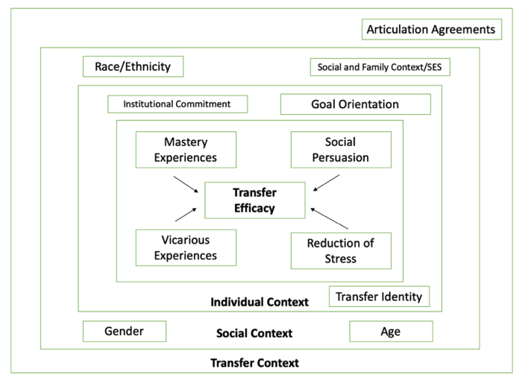
Transfer Efficacy Model (TEM) (Buenaflor, 2021)
The TEM model describes how community college students become self-efficacious to navigate the college transfer process.
TEM posits that a student's belief in being able to transfer to a university is shaped by four contextual influences which range from prior performance achievements (mastery experiences) to stress-reducing experiences.
These four sources have an impact on the goal orientation towards transfer, a goal that will ultimately determine transferring to a university.
Notes:
La autoeficacia puede definirse como las creencias que la persona tiene sobre sus capacidades para organizar y ejecutar acciones necesarias para realizar una tarea (Bandura, 1989).

Slide 10
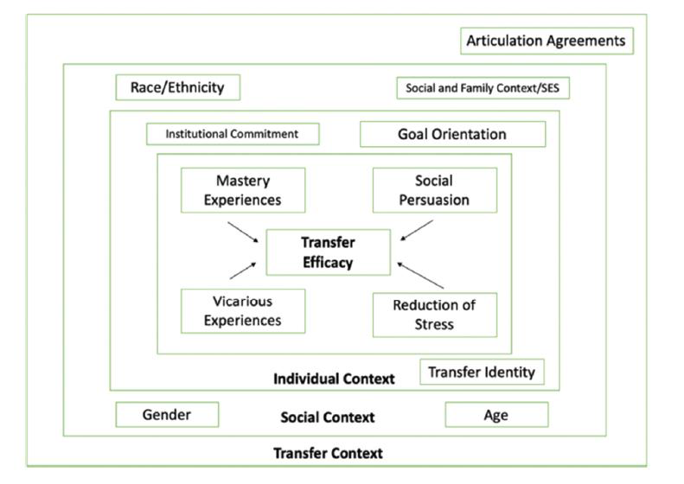
Translating the TEM model into a model susceptible to empirical testing
Conceptual model
Structural Equation Model
.
.
Mastery
Experiences
.
.
.
Social
Persuasion
.
.
Goal
Orientation
.
.
.
.
Vicarious
Experiences
.
.
Reduction
of
Stress
.
.
Notes:
Translating the conceptual model into a structural equation modeling of sources of transfer efficacy and their individual influence on goal orientation.

Slide 11
Methods
Data collection consisted of two phases.
Phase 1: Dealt with survey development aimed at capturing content valid item for the five core components of the the TEM model
Focus groups with three transfer students that assessed the content validity of the items based on the psychology of survey response theory (Tourangeau, Rips & Rasinski, 2000)
Accordingly, participants were asked to examine each item, recall critical incidents alluded by the content of the item and provide example
A short definition of the 5 constructs was made available to participants to assist them in their recalling process

Slide 12
 | Cognition Process Matrix
Construct/Item | Understanding Prompt questions: As you read each theme or behavior, tell me what comes to your mind for that item or theme? Give me examples? | Retrieval & Judgment Prompt questions: Please give me concrete examples of the actions or activities you engage in this theme or behavior | Response Prompt questions: How frequently do you engage in the actions or activities embedded into this theme or item? How important is it for you to be engaged in those actions or activities?
Vicarious experiences/ Have friends who transferred to a university
Reduction of stress/ Understand transfer policies
Social persuasion/ teacher told me I am ready to transfer
Goal orientation/ I have an academic plan for transferring
Basado en Tourangeau, R., Rips, L., y Rasinski, K. (2000). The psychology of survey response. Cambridge University Press.

Slide 13




Phase 2: Survey administration
Survey collection took place during spring 2022 using Qualtrics
Relied on on professional listservs to circulate the survey (e.g., NACADA) as well as Phi Theta Kappa to administer the survey among their partner organizations.
Also snowball sampling.
Students were entered into a raffle for an Apple iPad as an incentive.
1,810 respondents completed the survey

Slide 14
Who answered the survey?
Variable | N | %
Ethnicity
White | 871 | 48.1
Middle Eastern/North African | 22 | 1.2
African American | 205 | 11.3
American Indian/Alaska Native | 7 | 0.4
Asian American/Pacific Islander | 134 | 7.4
Latino/Hispanic | 193 | 10.7
Multiracial | 262 | 14.5
Other/unknown | 101 | 5.5
First generation to attend college | 519 | 28.9
Variable | N | %
Gender Identity
Male | 489 | 27.0
Female | 1,200 | 66.3
Non-binary | 55 | 3.0
Prefer not to say | 53 | 2.9
Age Group
Less than 22 | 694 | 38.3
22 – 39 | 738 | 40.8
40 or more | 378 | 20.9
Notes:
Our sample closely mirrors the 2022 community college student population (AACC, 2022), including a nearly identical proportion of first-generation college students (28.9% vs. 29%). However, there are slight discrepancies in the proportions of White students (48.1% vs. 44%), African American students (11.3% vs. 12%), and Asian American/Pacific Islander students (7.4% vs. 7%). Notably, our sample consists of 11% Latino/Hispanic students, which is significantly lower than their 27% representation in the 2022 community college population. Sixty-six percent of our sample is women, compared to 60% of the 2022 community college student population. Regarding age, 61% of our sample is 22 years or older, compared to 56% of community college students in 2022 who fall into this age group.

Slide 15

Exploratory factor analyses
Sources of self-efficacy
Instead of being grouped into four factors (as hypothesized), the self-efficacy items were grouped into five factors: 1) vicarious experiences, 2) reduction of stress, 3) social persuasion from community college personnel, 4) social persuasion from high school personnel, and 5) attending transfer fairs
These five factors account for 53.2% of the variance in the correlation matrix.
Goal orientation
Four indicators were grouped into a single factor. This factor accounts for almost 60% of the variance in the correlation. An indicator was removed.

Slide 16
Confirmatory Factor Analysis
The confirmatory factor analysis supports the use of the 19 items as valid indicators of the constructs. The loading of each item in the factor is above the recommended value of 0.5 (Brown, 2015).
Judging by the omega indicator (ω) (Raykov, 2009), each factor has a high degree of reliability, ranging from 0.70, as in the case of vicarious experiences, to 0.88 as in the case of goal orientation
The fit indicators support the model as a viable representation of the data.
Items | Goal Orientation ω = 0.88 |  | Reduction Stress ω = 0.74 |  | Advisor ω = 0.84 |  | Vicarious Experiences ω = 0.70 |  | Transfer Fairs ω = 0.81
 | Loading | S.E. | Loading | S.E. | Loading | S.E. | Loading | S.E. | Loading | S.E.
Selected major for a 4-yr degree | 0.749 | 0.013 | - | - | - | - | - | - | - | -
Have academic plan for transferring | 0.694 | 0.015 | - | - | - | - | - | - | - | -
Plan to submit college applications | 0.837 | 0.010 | - | - | - | - | - | - | - | -
Seeing oneself attending college | 0.814 | 0.011 | - | - | - | - | - | - | - | -
Completing gen ed facilitates transfer | - | - | 0.620 | 0.018 | - | - | - | - | - | -
Colleges’ websites facilitate understanding | - | - | 0.573 | 0.019 | - | - | - | - | - | -
Taking advanced math facilitates transfer | - | - | 0.515 | 0.021 | - | - | - | - | - | -
Attending small classes reduced concerns | - | - | 0.548 | 0.020 | - | - | - | - | - | -
Attending CC prepares for college | - | - | 0.588 | 0.019 | - | - | - | - | - | -
Understanding transfer policies help | - | - | 0.718 | 0.016 | - | - | - | - | - | -
Talked to friends about transferring | - | - |  |  | 0.791 | 0.015 | - | - | - | -
Academic advisor convinced being prepared | - | - | - | - | 0.809 | 0.013 | - | - | - | -
Faculty member convinced being prepared | - | - | - | - | 0.782 | 0.016 | - | - | - | -
Talked to friends about transferring | - | - | - | - | - | - | 0.626 | 0.019 | - | -
Have friends who transferred | - | - | - | - | - | - | 0.583 | 0.020 | - | -
Have friends at 4yr college want to transfer | - | - | - | - | - | - | 0.558 | 0.021 | - | -
Friends believe I can transfer | - | - | - | - | - | - | 0.673 | 0.019 | - | -
Have attended transfer fairs | - | - | - | - | - | - | - | - | 0.777 | 0.020
Attending transfer fairs helped feel prepared | - | - | - | - | - | - | - | - | 0.887 | 0.020
X² = 660.06, df = 139; p = 0.00; RMSEA = 0 .046 CI₉₀ = [[0.042, 0.049]; CFI = 0.958. ; TLI = 0.948 ; SMR = 0.037

Slide 17

Main research question:
What is the impact of self-efficacy on goal orientation among community college students?
Does the impact vary by self-efficacy component?

Slide 18
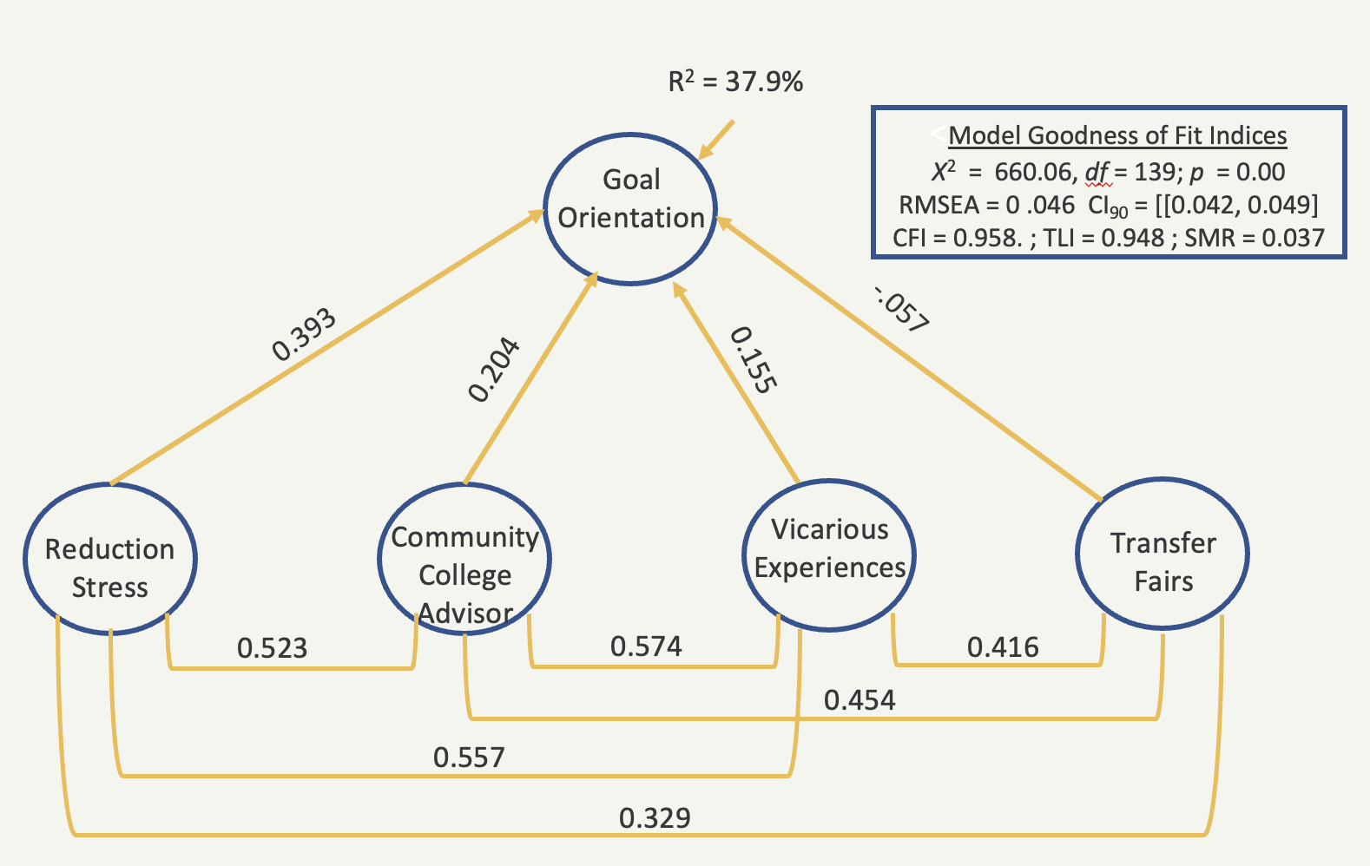
Impact of self-efficacy on goal orientation
The model is a viable representation of the impact of self-efficacy on goal orientation. With the sole exception of chi-square, all congruence indices “fit indices” are excellent.
It explains nearly 40% of the variance in goal clarity.
The effects range from a negligibly negative effect from transfer fair experiences (β = -.057), to a moderate high effect originating from reduction of stress (β = 0.393).
Social persuasion from community college advisors & professors had a positive but small effect on goal orientation (β = 0.204), so did vicarious experiences (β = 0.155).
Each source of transfer self-efficacy has a unique impact on goal orientation; however, each source is positively correlated.

Slide 19

Conclusions
Goal orientation towards transfer is based on having an academic plan, being proactive in obtaining academic skills, as well as having decided on the major to pursue. Seeing themselves attending college is another key manifestation of clarity of transfer goals among community college students.
Self-efficacy is key in shaping goal orientation among community college students. All sources of self-efficacy are shaped by empowering experiences at the community college (e.g., having friends who were successful in transferring to college (vicarious experiences), as well as being exposed to professors and advisors who validate one's ability to transfer (social persuasion)
Clear institutional agreements that facilitate an understanding of transfer policies, and how to meet them (reduction of stress) are key in ensuring students can achieve their transfer goals.

Slide 20

Questions?

Slide 21
What intervention strategies can you suggest based on this study? (Two perspectives)
From the perspective of the president of a community college who is committed at increasing the proportion of her students to eventually transfer to a four-year institution.
From the perspective of the president of a university who is committed at increasing the enrollment of community college graduates, and their success at her institution.
Notes:
In class exercise: Split the students into two groups. Assign each group one perspective.

Slide 22
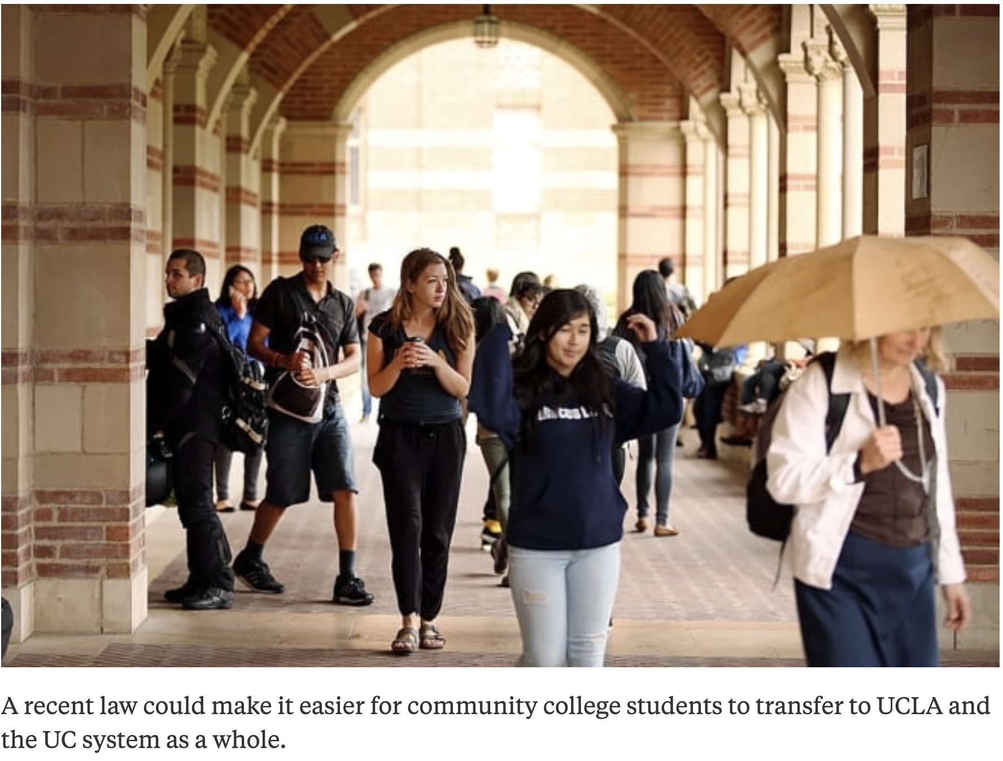


Some developments: At the state level
On October 31, 2023, the California legislature enacted a new law to facilitate the process of transferring community college students to UCLA and other universities in the California higher education system.
Weissman (October 31, 2023) A New Transfer Pathway to UCLA. Inside Higher Ed

Slide 23

Some developments: At the Federal level
The U.S. Department of Education published a list of community colleges and universities that stand out in facilitating transfer and success in college for community center graduates.
It also provides a list of those transfer agreements between community colleges and universities that are most successful.
Weissman (November 10, 2023) Inside Higher Education.

Slide 24
References
Anderson, D. M. & Strich, J. M. (2015). Goal clarity, task significance, and performance: Evidence from a laboratory experiment. Journal of Public Administration Research and Theory Advance Access. DOI: 10.1093/jopart/muv019
Bandura, A (1988). Organizational Application of Social Cognitive Theory. Australian Journal of Management, 13(2): pp. 275 - 302.
Bandura, A. (1994). Self-efficacy. In VS Ramachandran. Encyclopedia of Human Behavior, 4, 71-81.
Buenaflor, S. H. & Cabrera, A. F. (2023). Transfer efficacy and goal orientation among potential transfer students: An exploratory study. Paper presented before the annual meeting of the National Institute for the Study of Transfer Students (NISTS). Portland, Oregon.
Buenaflor, S.H. (2021). Transfer student self-efficacy: A success-oriented narrative of the transfer student experience. Community College Journal of Research and Practice, 1-16. https://doi.org/10.1080/10668926.2021.1967226
Laanan, F. S. (2007). Studying transfer students: Part II: Dimensions of transfer students’ adjustment. Community College Journal of Research and Practice, 31(1), 37-59. https://doi.org/10.1080/10668920600859947

Slide 25
References
Kezar, A. (2018). How colleges change: Understanding, leading and enacting change. Routledge
Knox, L. (2022). Transfer enrollments continue pandemic-driven decline. Inside Higher Ed.
Laanan, F. S., Starobin, S. S., & Eggleston, L. E. (2010). Adjustment of community college students at a four-year university: Role and relevance of transfer student capital for student retention. Journal of College Student Retention: Research, Theory & Practice, 12(2), 175-209. https://doi.org/10.2190/CS.12.2.d
Lent, R. W., Brown, S. D., & Hackett, G. D. Brown (ed.) (2002). Social cognitive career theory. In D. Brown (ed (ed), Career choice and development. 4th ed. (pp. 255–311). New York, NY: John Wiley & Sons
Lukszo, C. M., & Hayes, S. (2019). Facilitating transfer student success: Exploring sources of transfer student capital. Community College Review. doi: 10.1177/0091552119876017.
National Student Clearinghouse (March 25, 2024). Community College Enrollment & Other Mobility Trends in Fall 2023.
National Student Clearinghouse (March 9, 2023). Transfers from Community Colleges to Four-Year Colleges Drop Nearly 8% from Fall 2021 to Fall 2022
Tourangeau, R., Rips, L. J. & Rainski (2000). The psychology of survey response, Cambridge University Press.
Velasco, et al. (2024). Tracking transfer. College Research Center. Teachers College. Columbia University.
Wang, X. (2016). Upward transfer in STEM fields of study: A new conceptual framework and survey instrument for institutional research. New Directions for Institutional Research, 2016(170), 49-60. https://doi.org/10.1002/ir.20184

